Slide 1

Module 3 Virtual Reality
Theme: Mobile Applications
English
Grade:11
Term:2
Lesson:2
Night school

Slide 2

Learning objectives:
10.3.7 - use appropriate subject-specific vocabulary and syntax to talk about a range of general and curricular topics;
10.4.2 - understand specific information and detail in extended texts on a range of familiar general and curricular topics, and some unfamiliar topics;
10.6.4 - use a wide variety of determiners and pre-determiner structures on a wide range of familiar general and curricular topics;
Today you will be able to read for specific information and deduce meaning from context in extended texts; to practice using determines & pre-determines

Slide 3

Warm-up: What do you use below mobile apps for?

Slide 4

What other apps do you know? How useful are they?
upload pictures
browse maps
get directions
monitor the weather
play games
chat online
get breaking news
study for exams

Slide 5


Video time

Slide 6
Reading: “App Attack” SB ex.2 p.38-39 https://www.youtube.com/watch?v=iINqMhpr3W0

Slide 7
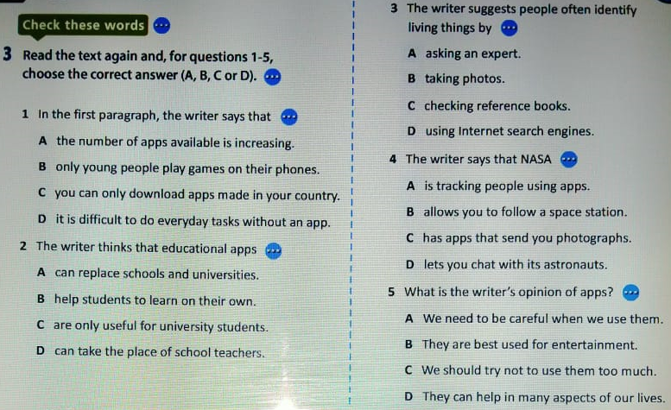
Task 1. Read the text and for questions 1-5 choose the correct answer (A,B,C,D)

Slide 8
Task 2. Fill in the phrases with these words: real, grab, live, keep, basic, go, top, independent, living, breaking
1. the ………………………..world | 6. in ……………………….. time
2. ……………………….. feed | 7. ……………………….. sb’s attention
3. ……………………….. news | 8. ……………………….. the touchscreen
4. ……………………….. learners | 9. ……………………….. sb updated
5. ……………………….. skills | 10. on the ………………………..

Slide 9
Task 3. Match the words in bold to their meanings
1. studying something you have already learnt
2. complete
3. do
4. plants & animals
5. almost immediately
6. watch in the Internet
7. watching & checking carefully
a) monitoring
b) perform
c) revising
d) within moments
e) flora and fauna
f) whole
g) stream

Slide 10
Grammar
Determines & pre-determines
Determiners are words such as a/an, the, this, that, these, those, my, your, his, her, its, our, their, ‘s (possessive ‘s), other, another, each, every, either, neither & quantifiers
They are used before a noun.
Pre-determiners are words such as all, both, half, twice, one-third, such, what, rather, quite, etc.
They come before determines to give more information or place more emphasis on the noun.

Slide 11
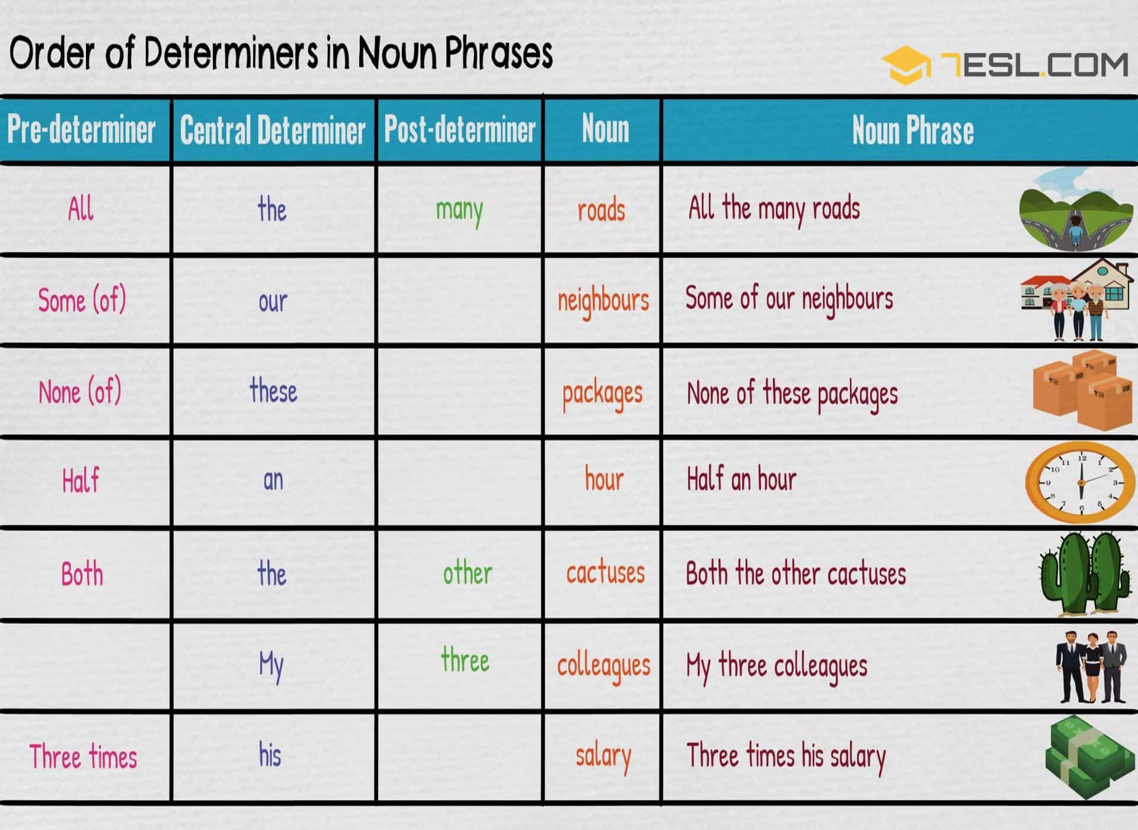
Grammar
Determines & pre-determines

Slide 12
Task 4. Let’s practice determiners & pre-determiners
1. Lisa saw _____ shooting star yesterday. a) a b) an c) the
2. Don't look directly at _____ sun. a) a b) an c) the
3. Is there any milk left in _____ fridge? a) a b) an c) the
4. I need to pack _____ apple for my lunch. a) a b) an c) the
5. The dogs were _____ given a bone. a) each b) any c) every
6. The police spoke separately to _____ suspect. a) every b) each c) some
7. She was wearing a bracelet on __________ wrist. a) each b) any c) every
8. She got her license without _____ problems. a) some b) any c) every
9. He went with __________ younger sisters. a) his both b) both his c) two his
10. I always keep _____ money in my wallet for emergencies. a) any b) every c) some

Slide 13
Let’s check your answers.
Task 1. A B D B D | Task 2. living live breaking independent basic real grab tap keep go | Task 3 C F B E D G A | Task 4. 1. a 2. the 3. the 4. an 5. each 6. each 7. each 8. any 9. both his 10. some

Slide 14
Reflection
Answer the questions below:
What have you remembered on the lesson today?
What was new for you?
What information was interesting for you?

Slide 15
Thank you! The lesson is over.
Good-bye!

